Slide 1

The Psychology of Procrastination
Uncover the hidden reasons behind procrastination. Learn practical strategies to regain control of your time and tasks.
Presented by [Your Name/Organization].
By Neha Henin

Slide 2
What is Procrastination?
More than Laziness
It's Common
Procrastination: Voluntarily delaying tasks, expecting a worse outcome (Steel, 2007).
About 20% of adults are chronic procrastinators (Ferrari et al., 2007).
It's different from prioritization or laziness.
Example: Starting taxes three days before the deadline.

Slide 3




Why We Procrastinate
Emotional Regulation
Temporal Discounting
Coping with negative feelings (Sirois & Pychyl, 2013).
Valuing immediate rewards over future ones.
Perfectionism
Unrealistic standards leading to avoidance.

Slide 4

The Procrastination Equation
Motivation Formula
Expectancy
Motivation = (Expectancy x Value) / (Impulsivity x Delay) (Steel, 2010).
Belief in your ability to succeed.
Value
How much you care about the outcome.
Boost expectancy and value. Minimize impulsivity and perceived delay.

Slide 5





Negative Impacts
Lower grades and increased stress.
Reduced productivity and missed chances.
Increased stress and health issues.
Relationship strain and broken trust.

Slide 6




Breaking the Cycle
Task Decomposition
Time Management
Goal Setting
SMART Goals.
Smaller, manageable steps.
Pomodoro Technique or time blocking.

Slide 7
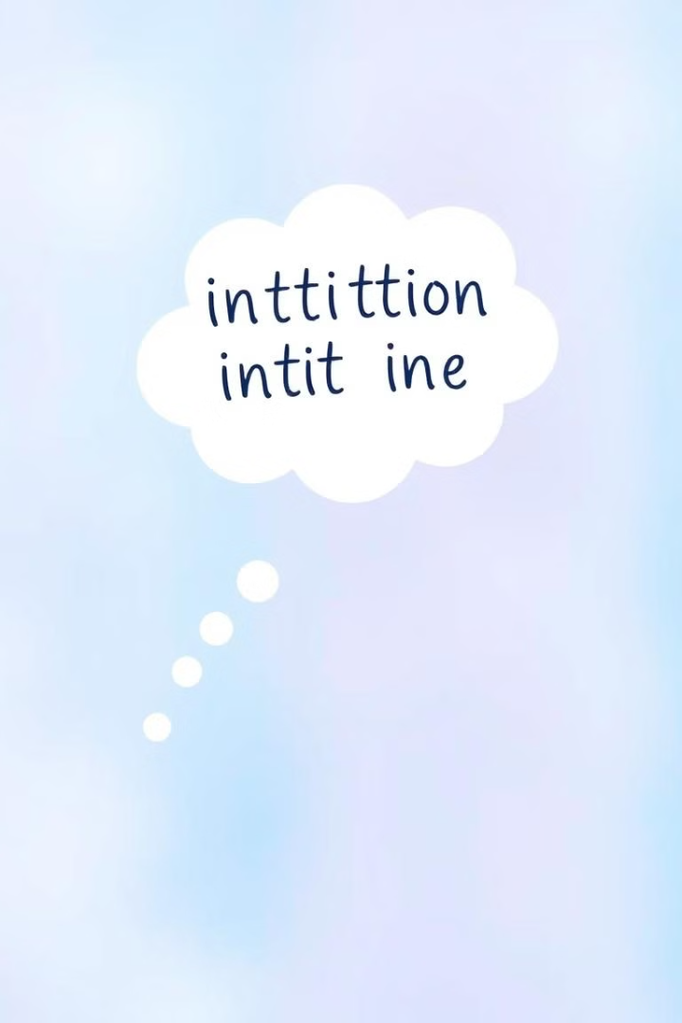
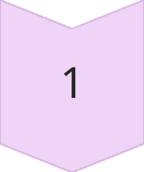
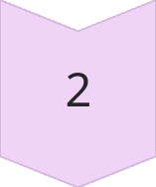
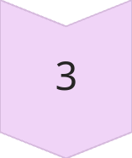
Turning Intention into Action
Implementation Intentions
"If-Then" plans linking situations to actions.
Commitment Devices
Increase the cost of procrastination.
Pre-commitment
Making choices ahead of time.

Slide 8



Changing Your Thinking
1
Challenge Negative Thoughts
2
Practice Self-Compassion
3
Reframe Tasks
Treat yourself with kindness. Focus on the positive aspects.

Slide 9
Procrastination-Proof Environment
Minimize Distractions
1
Turn off notifications.
Create a Routine
2
Consistent schedule.
Reward Yourself
3
Celebrate wins.

Slide 10

Take Action Today
1
2
3
Implement
Reflect
Seek Support
Try one strategy this week.
Know your triggers.
If needed.
Further reading: "The Procrastination Equation" and "Solving the Procrastination Puzzle."

